Slide 1
Lecture 5
Acquire Project Team

Slide 2
OVERVIEW
Acquiring project teams involves:
  Knowing pre-assigned resources
  Negotiating for best possible resources
  Preventing failure to acquire the right resources (what if the right resources are actually unavailable?)
  Hiring from outside the organization (outsourcing)
  Virtual teams – issues and benefits
  Managing risks associated with resources

Slide 3
Acquire Project Team – Overview (Cont’d…)
Types of Teams
  Dedicated, Most of team members work full time, easiest team to work, member can dedicate of the energy to work, most common in projectized org, found in matrix, least likely in functional org
  Part-time, spend part of time, also working on other projects or non project work, most often seen in functional and matrix org
  Partnership, where several org undertake project, saving of cost but difficult to manage
  Virtual, multiple organization or offices involved, geographical distance necessitate v teams
Avoiding Pitfalls
  Halo Effect, Halo effect is a concept of unconscious judgment, it is a biased Approach in which an observer's overall impression of some thing. Its works in both positive and negative directions
  Acquire Project Team = Acquire Final Project Team
  Involving people in the work regardless of when they join the project team

Slide 4
Acquire Project Team
Acquiring qualified/Talented people for teams is crucial.
Staffing plans and good hiring procedures are important, as are incentives for recruiting and retention.
  Some companies give their employees cash rewards for every hour that a new person who they helped hire works.
  Some organizations allow people to work from home as an incentive.

Slide 5
Acquire HR as People Leave Jobs!
Acquire Project Team
They feel they do not make a difference.
They do not get proper recognition.
They are not learning anything new or growing as a person.
They do not like their coworkers.
They want to earn more money.

Slide 6
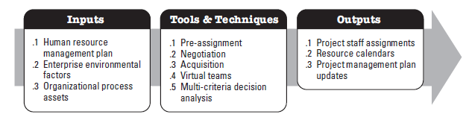
Acquire Project Team

Slide 7
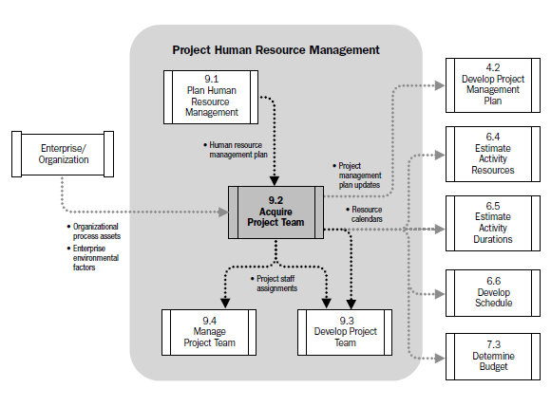
Acquire Project Team

Slide 8
Acquire Project Team - ITTOs
Inputs
  Human Resource Management Plan
  Enterprise Environmental Factors
  Organizational Process Assets
Tools & Techniques
  Pre-Assignment
  Negotiation
  Acquisition
  Virtual Teams
  Multi-criteria Decision Analysis
Outputs
  Project Staff Assignments
  Resource Calendars
  Project Management Plan Updates

Slide 9
Important Factors
;
Collective Bargaining Agreements
Use of Sub-Contractor Personnel
Matrix Project Environment
Internal or External Reporting Relationships

Slide 10
Important Factors
Project Management Team may or may not have direct control over team member selection
Affect of the Non- availability of necessary human resource on;
  Project Schedule
  Project Budget
  Project Risks
  Project Quality
  Training Plans
  Project Management Plans as a whole

Slide 11
Acquire Project Team Inputs
Human Resource Management Plan
Enterprise Environmental Factors
Organizational Process Assets

Slide 12
Human Resource Management Plans Inputs
How Project Human Resource should be;
Roles & Responsibilities defining the positions, skills and competencies that the project demands.
Project organization charts indicating the number of people needed for the project.
Staffing management plans elucidating the time periods each project member will be needed and other information important to engage the project team.
Identified
Staffed
Managed
Released

Slide 13
Enterprise Environmental Factors Inputs
EEF refer to conditions, not under the control of the project team, that influence, constrain or direct the project . These include but not limited to;
Existing information on Human Resources including availability, competency levels, prior experience, interest in working on the project and their cost rate.
Personal administration policies such as those which can effect outsourcing.
Organization structures as described in
Colocation or multiple locations.

Slide 14
Organizational Process Assets Inputs
Organizational Process Assets are the plans, procedures, processes and knowledge base specific to and used by the performing organization. OPA may be grouped into two categories;
Processes and Procedures
Initiating & Planning
Executing, Monitoring & Controlling
Closing
Configuration management knowledge base
Financial databases
Historical information and lessons learned.
Issue and defect management database.
Process measurement database.
Project files.
Corporate Knowledge Base

Slide 15
Acquire Project Team Tools & Techniques
APT T&T
Pre-Assignment
Negotiation
Acquisition
Virtual Teams
Multi-Criteria Decision Analysis

Slide 16
Pre-Assignment Tools & Techniques
When project team members are selected in advance, they are considered pre-assigned.
The situation can occur if;
The project is the result of specific people being identified as part of a competitive proposal.
If the project is dependent upon the expertise of particular persons.
If some staff assignments are defined within the project charter.

Slide 17
Negotiation Tools & Techniques
Staff assignments are negotiated on many projects. The project management team may need to negotiate with;
To ensure that the project receives appropriately competent staff in the required time frame
Project team members will be able, willing and authorized to work on the project until their responsibilities are completed.
Functional Managers
Other project management teams within the performing organization, to appropriately assign scarce or specialized human resources
Other Project Management Teams
For appropriate, scarce, specialized, qualified, certified or other such specified human resources.
Special considerations should be given to external negotiating policies, practices, processes, guidelines, legal and other such criteria
External Organizations

Slide 18
Negotiation Tools & Techniques
The project management’s team ability to influence others plays an important role in negotiating staff assignments, as do the politics of the organization involved.
As an example, a functional manager will weigh the benefits and visibility of competing projects when determining where to assign exceptional performers requested by various project teams.

Slide 19
Negotiation Tools & Techniques
Negotiation process involves in dealing with another person or party to settle a matter.
In successful negotiation, everyone wins
Objective should be agreement not victory
Settlement of issue for benefit of all parties
Two essential things for negotiation. Influence & Confidence
Negotiation Process (3Fs)
Fair, Fast and Firm

Slide 20
Negotiation Tools & Techniques
During Negotiation;
Be firm yet polite when making a stand.
Emphasize advantages & disadvantages of your approach.
Put ego aside and concentrate on the matter at hand.
Aim for solutions that are interest based and not based only on what any individual desires.
Value time, schedules and deadlines. Try not to waste time, but be sensitive to the other party’s needs to discuss.

Slide 21
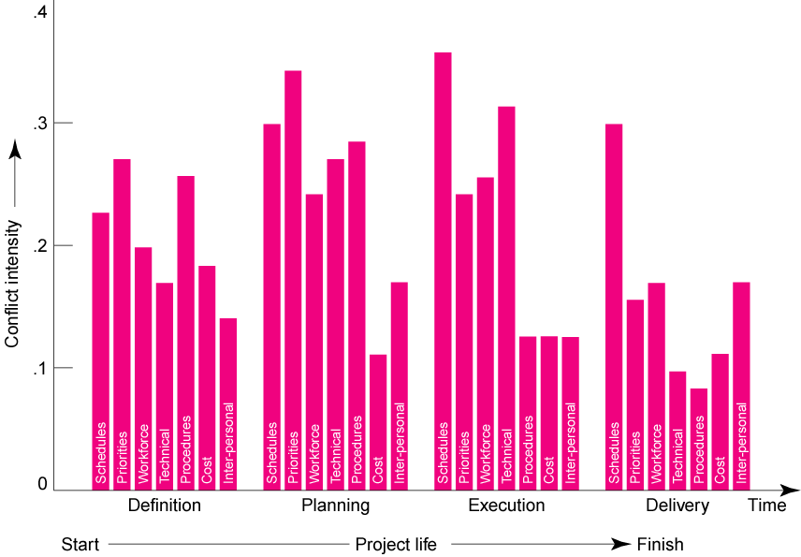
Negotiation Tools & Techniques

Slide 22
Acquisition Tools & Techniques
When the performing organization is unable to provide the staff needed to complete a project, the required services may be acquired from outside sources.
Hiring Individual Consultants
Subcontracting work to other organization
Outsourcing
Near-sourcing

Slide 23
Acquisition Tools & Techniques
Outsourcing Advantages
Cost Reduction
Faster Project Completion
High Level of Expertise
Flexibility

Slide 24
Acquisition Tools & Techniques
Outsourcing Disadvantages
Coordination Breakdowns
Loss of Control
Conflict
Security Issues

Slide 25
Virtual Teams Tools & Techniques
A new possibility of acquiring project team members
Disadvantages;
Possibility of misunderstandings.
Feeling of isolation.
Difficulties in sharing knowledge and experience between team members.
Appropriate technology.
Importance of communication planning.
Additional time for conflict resolution, decision making, cultural differences, sharing of success credit.
Advantages;
Teams from widespread geographical areas.
Addition of special expertise.
Different shifts, days, hours.
Mobility limitations and disabilities.
Overcome project constraints of travel expense.

Slide 26
Virtual Teams Tools & Techniques
Challenges:
  Developing trust
    Exchange of social information.
    Set clear roles for each team member.
  Developing effective patterns of communication.
    Include face-to-face if at all possible.
    Keep team members informed on how the overall project is going.
    Don’t let team members vanish.
    Establish a code of conduct to avoid delays.
    Establish clear norms and protocols for surfacing assumptions and conflicts.

Slide 27
Multi-Criteria Decision Analysis Tools & Techniques
Criteria are developed and used to rate or score potential team members
The criteria are weighed according to the relative importance of the needs within the team
Availability
Cost
Experience
Ability
Knowledge
Skills
Attitude
International Factors

Slide 28
Acquire Project Team Outputs
Outputs
Project Staff Assignments
Resource Calendars
Project Management Plan Updates

Slide 29
Project Staff Assignments Outputs
The project is staffed when appropriate people have been assigned to the team
The documentation of these assignments can include;
Project team directory.
Memos to team members.
Names inserted into other parts of the project management plan such as project organization charts and schedules.

Slide 30
Resource Calendars Outputs
It documents the time periods that each project team member is available to work on the project.
Creating a reliable schedule depends on having good understanding of each person’s availability and schedule constraints including;
- Time zones
- Working hours
- Vacation Time
- Local Holidays
- Commitments to other projects

Slide 31
Project Management Plan Updates Outputs
Elements of the project management plan that may be updated include, but are not limited to, the human resource management plan.
For example, the person assigned to a predefined role may not fulfill all staffing requirements outlined in the human resource management plan. When gaps occur, the project management plan needs to be updated to change the team structure, roles or responsibilities.

